Slide 1
Doctor Search Website
Project Website: https://getadoc.000webhostapp.com/
Presentation by: Nimit Zakharia

Slide 2
Table of contents
SR No. | Title | Slide no.
1 | Project Goals | 3
2 | Designing the Web-App | 5
3 | Hosting and Creating the Database | 6
4 | Creating the Backend APIs and Unit Testing | 9
5 | Connecting the Frontend and the Backend API | 12
6 | Project Demo | 16
7 | Q&A | 17

Slide 3
Develop a Doctor Search Website
Project Goals:
Understand the use of Figma for designing web applications
Use of Figma plugins like Anima and locofy for converting designs into HTML and CSS code to save development time
Understand how to create database and webservices to search doctors.
Perform backend webservices testing using software like postman.
Integrate the frontend and the backend

Slide 4


Designing the Web-App
I used Figma to create the Initial design for the web application. To get some inspiration I went to uplabs.com which is a website that contains web design files and templates. Figma helps us create some quicky prototype ideas which we can share with the clients help them understand what to expect, and they can communicate any changes.
Then I used Locofy which converts the design to actual HTML and CSS code quickly saving developers a lot of time. It also can add basic animations to buttons and links , create input forms ,etc.
Figma
Locofy

Slide 5



Hosting and Creating the Database
Next step was to host the website by uploading all the necessary files to 000webhost and create a database with doctors to search from.
HTML
CSS
000webhost

Slide 6
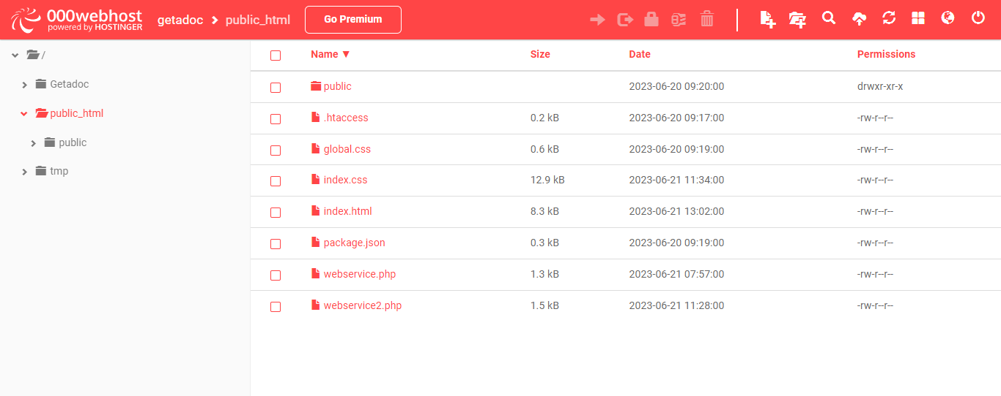
Uploaded the code to 000webhost

Slide 7
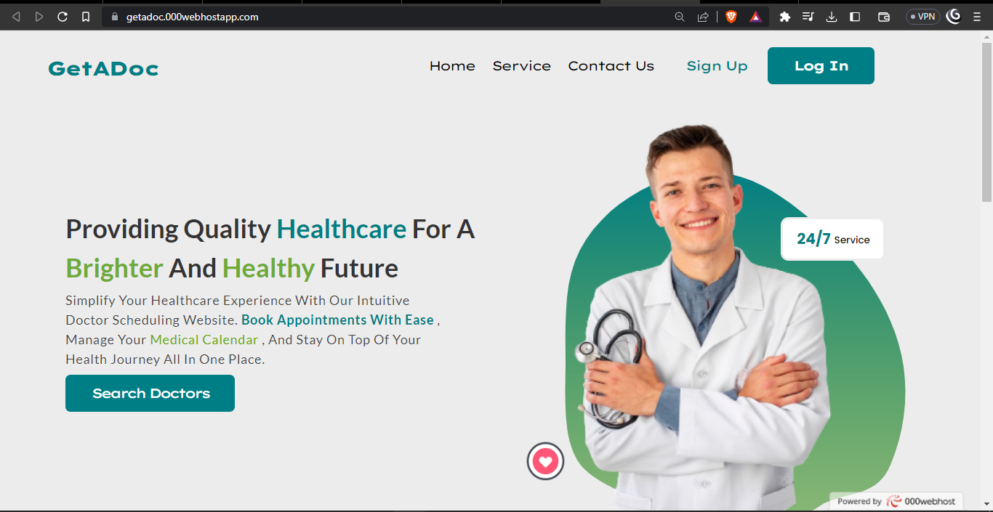
Website hosted at: https://getadoc.000webhostapp.com/

Slide 8
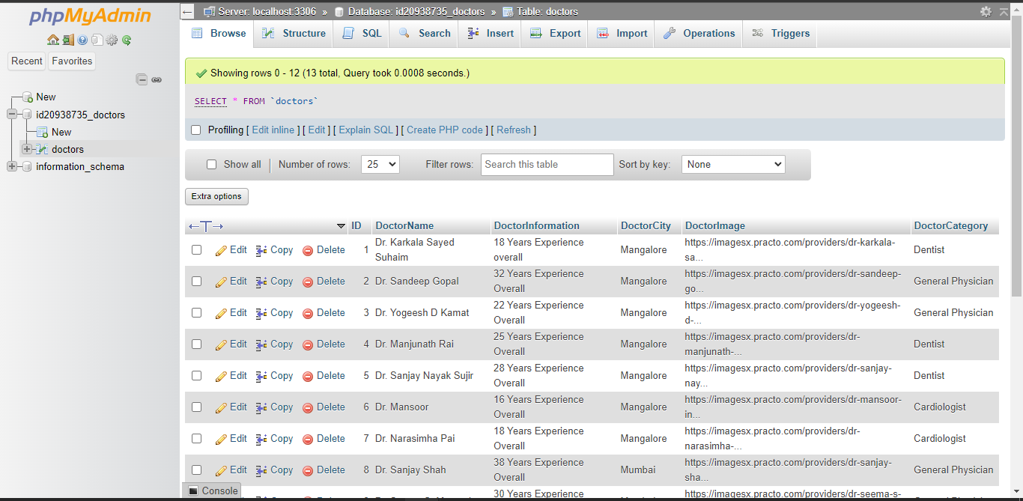
Database created for GetADoc webapp

Slide 9


Creating the Webservices and Unit Testing
The next step was to create the webservices to interact and fetch data from the Backend. I created the webservices using php and performed unit testing using Postman.
PHP
Postman

Slide 10
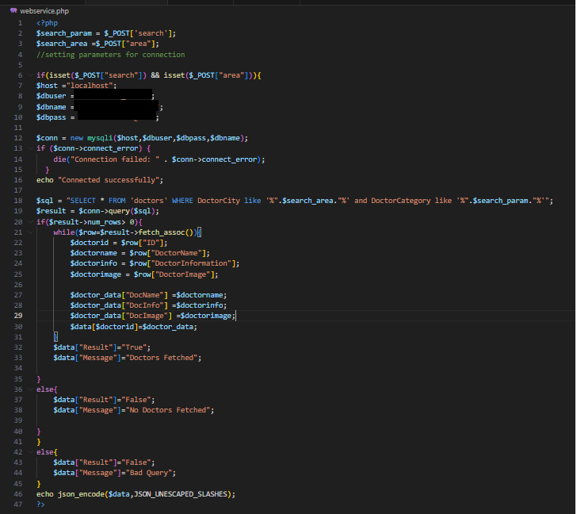
Code Snippet for Webservice1.php

Slide 11
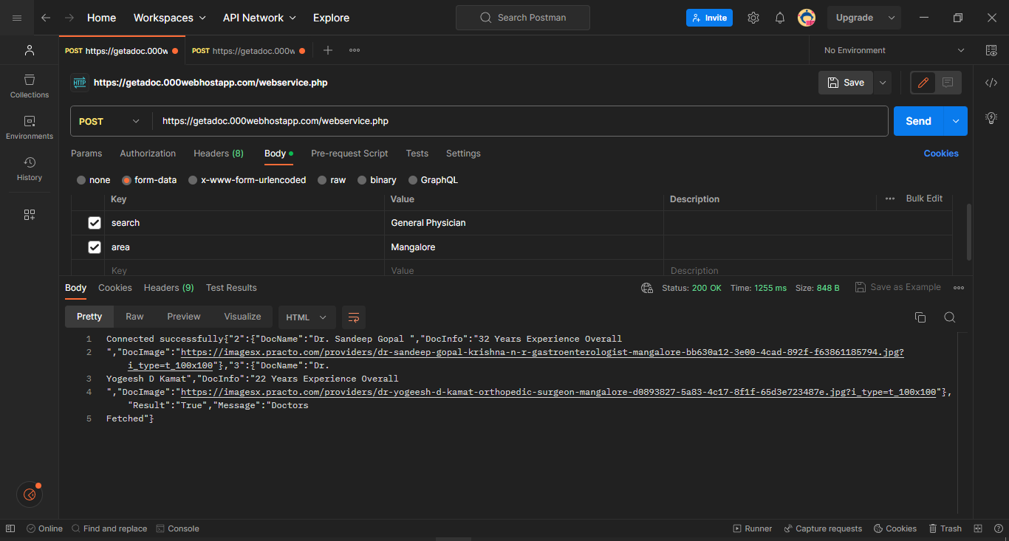
Testing webservice1.php with Postman

Slide 12

Connect the Frontend with the Backend APIs
Then I created the webservice2 which fetches the data from the database according to the parameters entered by the User and returns HTML code which is then rendered by the browser and displayed to the user.
I used jQuery on the frontend to take inputs from the user and the call the backend webservice that returns the results in the form of HTML tags
jQuery
PHP

Slide 13
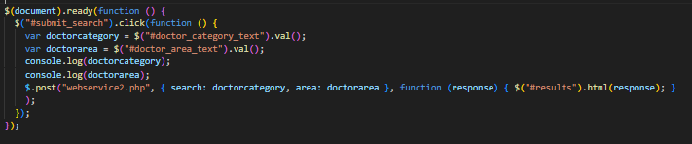
jQuery code snippet to get input from User

Slide 14
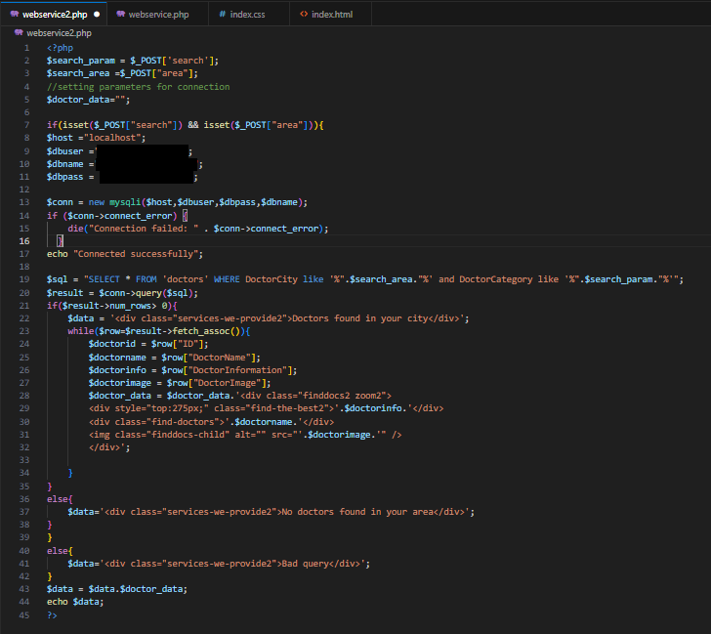
Code Snippet for Webservice2.php

Slide 15
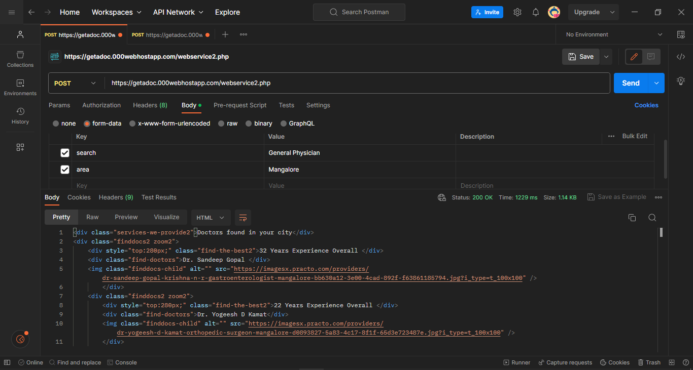
Testing webservice2.php with Postman

Slide 16
Project DEMO

Slide 17
Q&A

Slide 18
Thank You!

